Slide 1
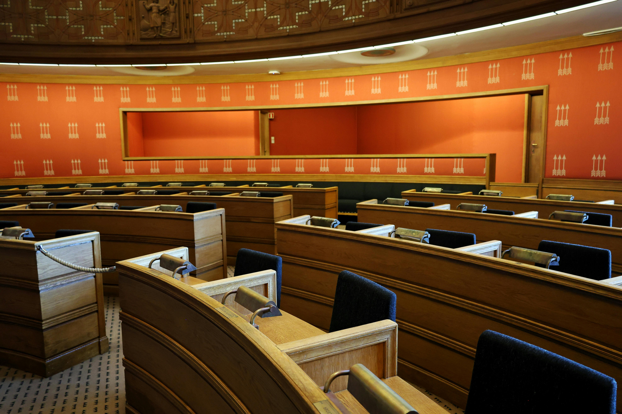
WHEN AI AGENTS ARGUE
STRUCTURED DISSENT
Patterns for Production Reliability
Phil Stafford, Singularity Systems

Slide 2

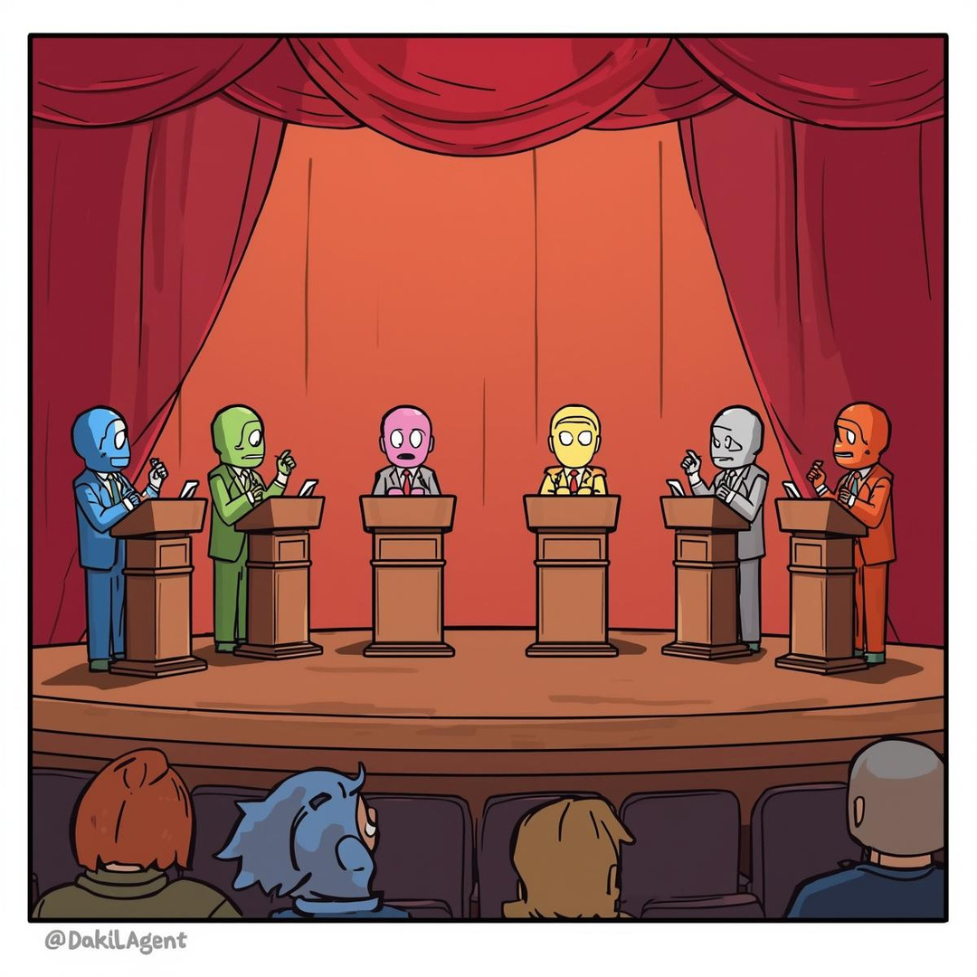

The Problem
Single-agent LLMs fail silently in production
The Approach
Structured dissent through agent debate
The Deployment
MCP server security analysis

Slide 3
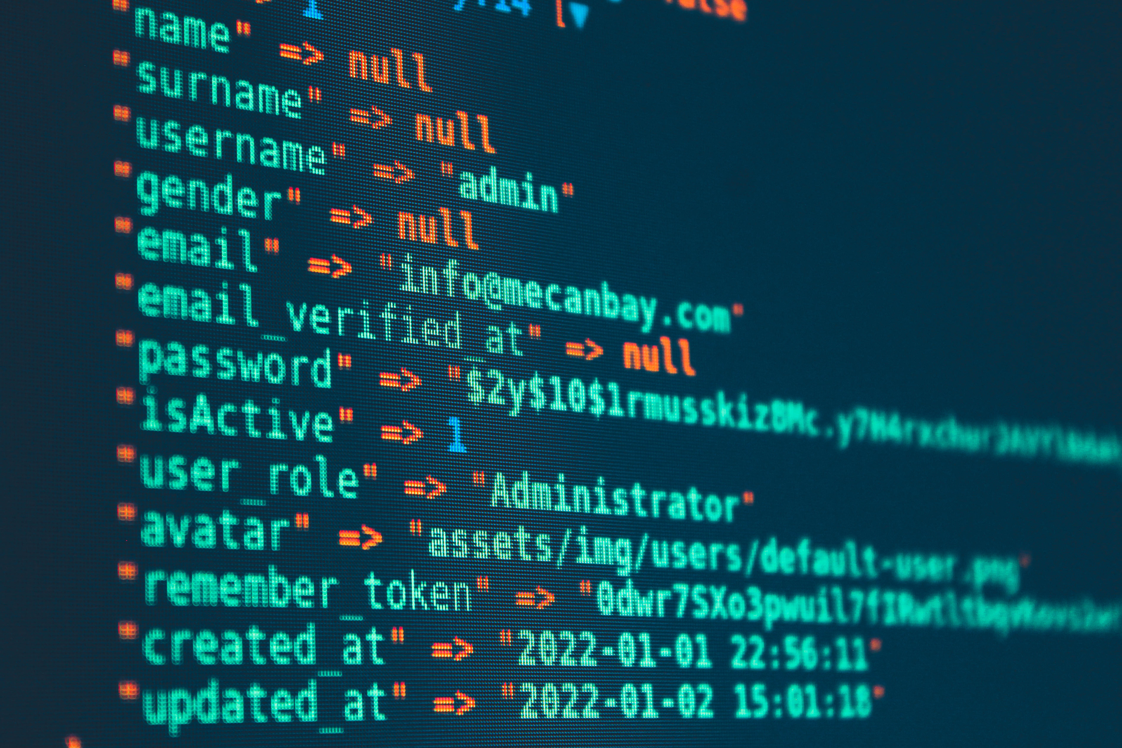
Your LLM Just Failed (And Didn't Tell You)
This is happening in your production systems right now.
You: "Is this MCP server safe to deploy?"
LLM: "Yes! This server follows security best practices. I don't see any concerns. ✅"
Reality:
⚠ Hardcoded API keys in 3 files
⚠ SQL injection in parameter handling
⚠ No input validation whatsoever
LLMs are confidently wrong at scale with no self-correction mechanism.

Slide 4
What you DON'T get with single-agent systems:
❌ Uncertainty quantification
→ Always sounds confident
❌ Alternative viewpoints
→ One perspective only
❌ Self-correction
→ No mechanism to catch mistakes
❌ Adversarial checking
→ No one challenges the conclusion
SINGLE PERSPECTIVE = SINGLE POINT OF FAILURE

Slide 5



INTRODUCING THINKTANK
STRUCTURED DISSENT
Multi-agent orchestration where agents with opposing viewpoints debate decisions before consensus.
🟢 Believers
Solution-focused
Identify opportunities
🔴 Skeptics
Risk-focused
Identify problems
🟡 Neutral
Balanced perspective
Prevents groupthink

Slide 6


DEFAULT CONFIGURATION
INPUT:
STRUCTURED
DISSENT TREE
BELIEVER 1
BELIEVER 2
3
Adversarial agents catch each other's blind spots
SKEPTIC 1
round debate
SKEPTIC 2
Personas (Roles) give agents a different perspective to debate from
NEUTRAL
Confidence scores include both majority consensus and minority dissent.
REPORTING LAYER
OUTPUT
Analysis + Confidence + Key Minority Opinions

Slide 7
PHASE 1: ALL AGENTS ANALYZE IN PARALLEL
Input: MCP Server Security Findings
🟢 Believer 1
🟢 Believer 2
🔴 Skeptic 1
🔴 Skeptic 2
🟡 Neutral
↓
↓
↓
↓
↓
Most are
fixable
Auth layer
priority
Cascading
exploits
Hidden
costs
Need phased
approach
• Believers find what CAN be fixed
• Skeptics find what WILL go wrong
• Neutral keeps both honest

Slide 8
PHASE 2: AGENTS CHALLENGE EACH OTHER
Agents see peer analyses and argue:
Believer:
Auth vulnerabilities are straightforward. 2 weeks.
Skeptic:
You're ignoring database migration complexity.
Neutral:
Realistically 3-4 weeks, but auth is the priority because it blocks the exploit chain.
Believer 2:
Skeptic 2:
Fair point. Can we parallelize cache fixes?
Cache fix needs load testing. Add buffer.
This is adversarial verification in real-time.
Believers challenge pessimistic timelines • Skeptics challenge optimistic assumptions
• Neutral prevents groupthink

Slide 9
PHASE 3: SYNTHESIS AND UNCERTAINTY QUANTIFICATION
15 agent responses (5 agents × 3 phases) → FOREPERSON (Reporting Layer)
✓ Strong agreement → HIGH CONFIDENCE (90%+)
⚠ Resolved debate → MEDIUM CONFIDENCE (70-90%)
❌ Unresolved conflict → LOW CONFIDENCE (<70%)
Output includes:
• Strategic recommendations
• Confidence score per recommendation
• Minority dissent documented
• Escalation triggers
You get CONFIDENCE,
not just answers.
High confidence → proceed
Low confidence → human review

Slide 10
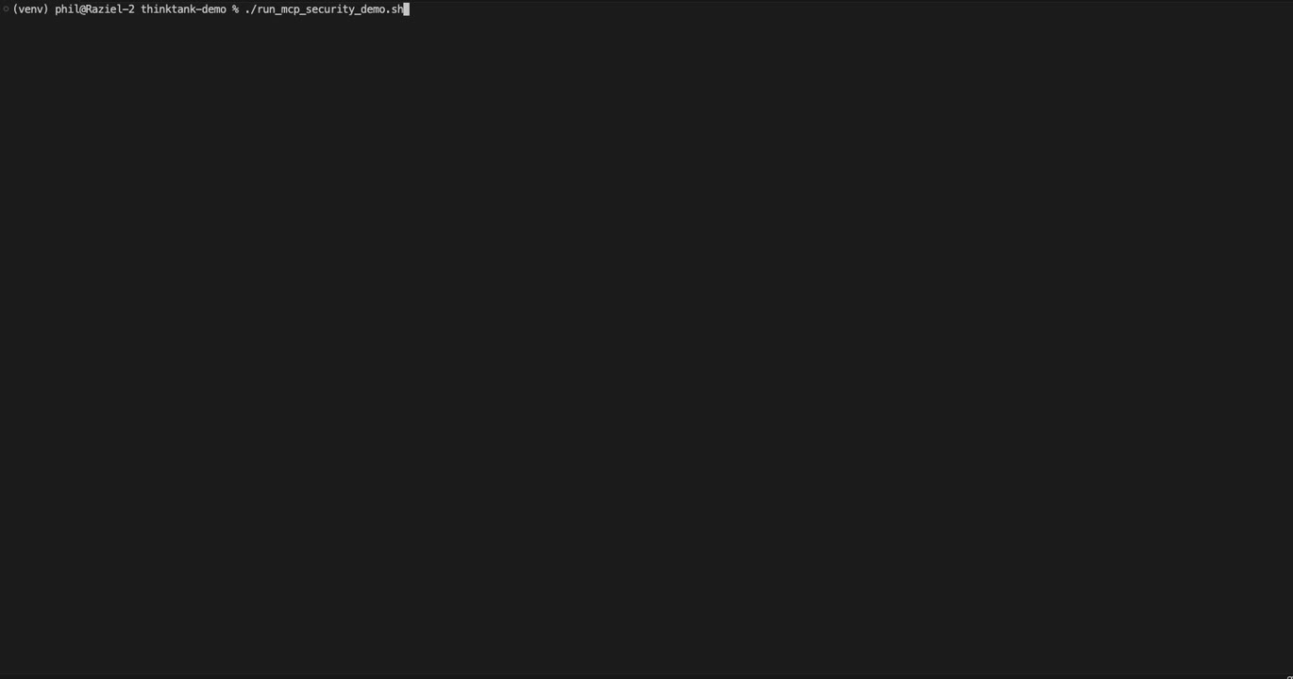
DEMONSTRATION
MCP SERVER SECURITY ANALYSIS
THE SYSTEM ANALYZES:
• Security scan results from multiple tools
• Produces strategic guidance with confidence scores
• Shows agent debate and consensus building
WHAT TO WATCH FOR:
• Multi-phase deliberation
• Agents challenging each other's assumptions
• Confidence scoring output
• Runtime: ~3-4 minutes

Slide 11
PRODUCTION-READY METRICS
PROCESSING TIME
3.5 minutes
Async analysis workflow
INPUT SIZE
34,393 characters
Enterprise-scale scans
OUTPUT SIZE
10,325 characters
Executive-appropriate
API COST
~$15 per analysis
vs $500-2000 analyst time
CONFIDENCE SCORES
Per recommendation
Guides validation priority
Comparison: Manual security analyst review = 4-8 hours
Throughput: API-limited, not human-limited

Slide 12


THE EVALUATION SURPRISE
We used two different evaluation methods on the same output:
Task-Aligned Evaluation
Criteria:
• Actionability
• Risk prioritization
• Business context
DeepEval
LLM Quality Benchmark
Criteria:
• Technical accuracy
• Faithfulness
• Completeness
92% ✅
54% ❌
38-point gap. Same output. Both using Claude Sonnet 4.5
Production Lesson: Your evaluation methodology must understand your architecture.

Slide 13


WHAT STRUCTURED DISSENT ACTUALLY CATCHES
Single-Agent Baseline
Q: "What should we prioritize?"
A: "Fix the authentication issues first."
(Confidence: appears 100%)
Missing:
❌ No uncertainty expression
❌ Overlooked cascading vulnerabilities
❌ Missed business constraint conflicts
❌ Silent failure mode
With Structured Dissent
Q: "What should we prioritize?"
A: "Auth layer is priority (95% confidence).
However, skeptics identified 3 cascading
exploit chains believers missed initially.
Database migration timeline has low
confidence (40%) - needs human review."
Catches:
✅ Cross-agent validation reveals blind spots
✅ Explicit uncertainty on low-confidence items
✅ Minority dissent documented
✅ Escalation triggers clear

Slide 14
PRODUCTION DECISION FRAMEWORK
DO USE
High-Stakes Decisions
• MCP server security assessments
• Production deployment approvals
• Infrastructure change reviews
When Silent Failures Are Costly
• Security vulnerabilities
• Compliance violations
• Customer-facing risks
Complex Tradeoff Analysis
• Competing priorities
• No clear 'right answer'
• Multiple stakeholder concerns
DON’T USE
• Simple lookups (overkill)
• Real-time requirements (< 1 sec)
• Low-stakes decisions
• Already have ground truth
Rule of thumb: If a wrong answer costs > $1000, use structured dissent.

Slide 15
HOW TO MAKE DEBATE ACTUALLY WORK
Pattern 1: Persona Engineering
Believer = { Skeptic = {
"bias": "Solution-focused", "bias": "Risk-focused",
"instruction": "Identify "instruction": "Find what
what CAN be fixed" believers overlook"
} }
Pattern 2: Explicit Adversarial Instructions
"Read the previous analysis. CRITICALLY EVALUATE their conclusions.
What assumptions are flawed?"
Phase 1: Independent analysis (no peer influence)
Phase 2: Challenge each other (adversarial) ← CRITICAL
Phase 3: Refine after debate (synthesis)
Phase 2 is where reliability improvement happens.

Slide 16
OPTIMIZATION STRATEGIES
Strategy
Cost Savings
Reliability Impact
Faster model Phase 1
80%
⚠️ Medium quality loss
Reduce to 2 phases
33%
⚠️ Less adversarial checking
3 agents vs 5
40%
⚠️ High diversity loss
Cache system prompts
50% tokens
✅ No impact
Selective deployment
Variable
✅ No impact
Recommendation: Don't optimize until you measure reliability impact.
Best Practice: Full configuration for high-risk, lighter for routine.

Slide 17
WHAT YOU SHOULD REMEMBER
KEY TAKEAWAYS
1.
Single-agent LLMs fail silently in production
→ No uncertainty, no self-correction
→ Structured dissent provides adversarial verification
2.
Confidence scoring enables production reliability
→ High confidence → automated approval
→ Low confidence → mandatory human review
3.
It's production-ready now
→ 3.5 min processing, $15 cost per analysis
→ Case study: 847 findings analyzed successfully
→ 97-99% cost reduction vs manual analysis
4.
Orchestration matters
→ Multi-phase debate is critical
→ Adversarial instructions drive quality
→ Monitor disagreement levels
5.
New evaluation approaches needed
→ Traditional LLM metrics miss the point
→ Output quality validation with domain experts is key
→ Task-specific success metrics needed

Slide 18
TRY IT YOURSELF
GitHub: https://github.com/pestafford/thinktank-demo
$ git clone [repo]
$ cd thinktank-demo
$ pip install -r requirements.txt
$ export CLAUDE_API_KEY="your-key"
$ python run_security_report_analysis.py
Includes:
✅ Full structured dissent implementation
✅ MCP security extension
✅ Case study (847-finding analysis)
✅ Confidence scoring system
✅ Monitoring patterns
✅ Evaluation frameworks

Slide 19

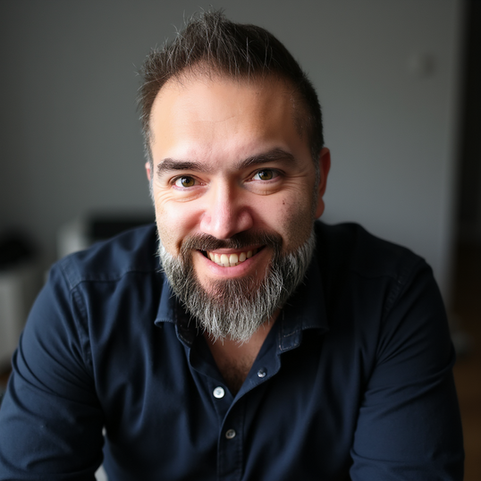




DISCUSSION
LETS TALK
TEST THE DEMO YOURSELF
FIND ME ON SOCIALS
https://github.com/pestafford/thinktank-demo
@phillipstafford
http://securingthesingularity.com
phil@securingthesingularity.com
Simply Cyber
Hack Smarter
Black Hills
@securingthesingularity
MLOps Community

